Slide 1
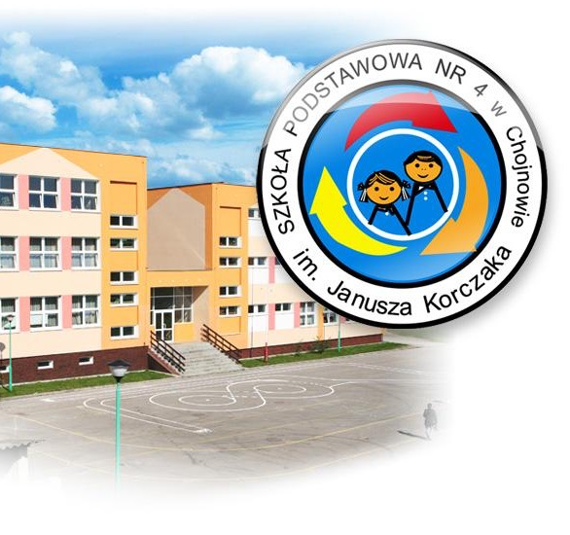
35TH
anniversary
of our school

Slide 2
Our school The school was established in 1986. The headmaster of our school is Mrs Beata Miler-Kornicka. There are 800 students and 60 teachers in our school. The school consists of two buildings, which are big and modern. Inside the buildings there are gyms, IT suites, science labs, language classrooms, geography classrooms and many other classrooms where we learn Polish, maths or biology. All classrooms are well-equipped: there are new computers, interactive boards, microscopes, educational posters and new furniture. There is also a huge school canteen in one of the buildings. There are places in the school where students can talk, eat, play board games or table tennis during breaks. After lessons, we can participate in extracurricular activities to play handball or football, learn languages, art and craft, dance or swim. Our handball and football teams win a lot of competitions in Poland and abroad. The students can take part in different subject contests or projects. The projects are usually about environment protection, violence, addictions and a healthy lifestyle. Sometimes there are charity events in our school during which students and their parents can take part in lotteries, buy home-made decorations, desserts or fresh squeezed juice and watch performances of many talented students. Welcome to visit our website! The author: JULIA PAWLAK VIIC
Nasza szkoła
Szkoła istnieje od 1986. Dyrektorką jest pani mgr Beata Miler-Kornicka. Szkoła liczy 800 uczniów i 60 nauczycieli i tworzą ją dwa budynki, które są duże i nowoczesne. W środku znajdują się sale gimnastyczne, sale komputerowe, laboratoria chemiczne, sale językowe, sale geograficzne i wiele innych sal, gdzie uczymy się języka polskiego, matematyki czy biologii. Wszystkie sale są dobrze wyposażone- mamy nowe komputery, interaktywne tablice, mikroskopy, plakaty edukacyjne i nowe meble. W jednym z budynków znajduje się również ogromna stołówka. W szkole uczniowie mają też miejsca, gdzie mogą porozmawiać, zjeść, pograć w gry planszowe lub tenisa stołowego podczas przerw. Po lekcjach uczestniczymy w zajęciach dodatkowych, podczas których gramy w siatkówkę lub piłkę nożną, uczymy się języków obcych, rozwijamy talenty artystyczne, tańczymy lub pływamy. Nasi siatkarze i piłkarze wygrywają wiele zawodów w Polsce i za granicą. Nasi uczniowie biorą udział w różnych konkursach przedmiotowych i projektach. Projekty dotyczą zazwyczaj ochrony środowiska, przemocy, uzależnień i zdrowego stylu życia. Czasami organizowane są imprezy charytatywne, podczas których uczniowie i ich rodzice biorą udział w loteriach, kupują ręcznie robione dekoracje, desery i świeżo wyciskane soki oraz oglądają występy wielu utalentowanych uczniów. Zapraszamy do odwiedzania naszej strony internetowej!

Slide 3
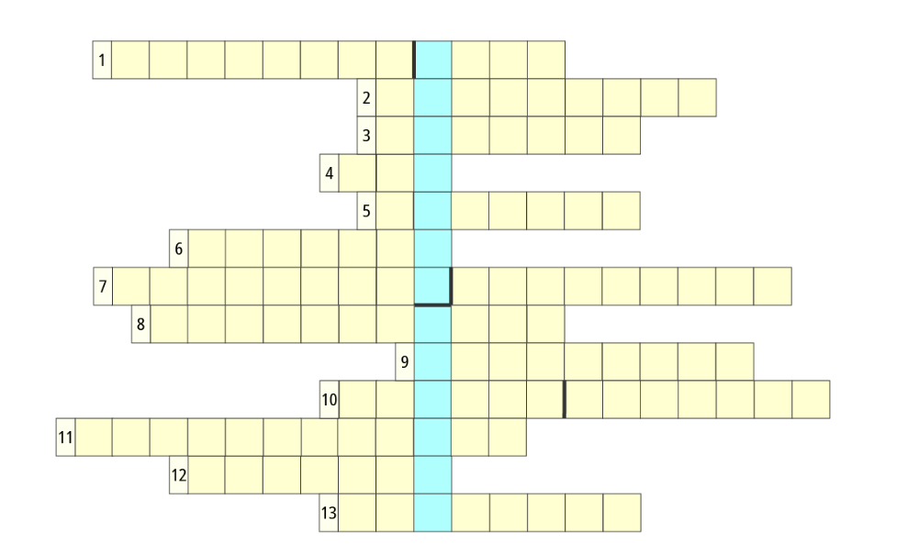
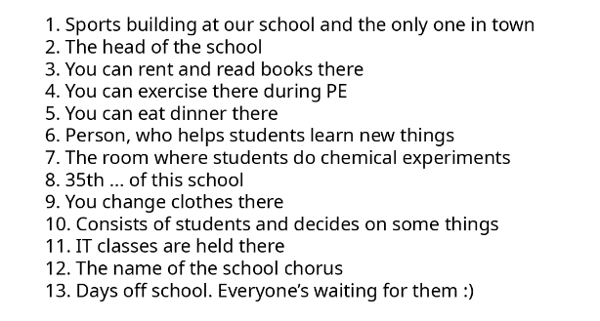
Crossword
The author: Dawid Jamry VII B

Slide 4
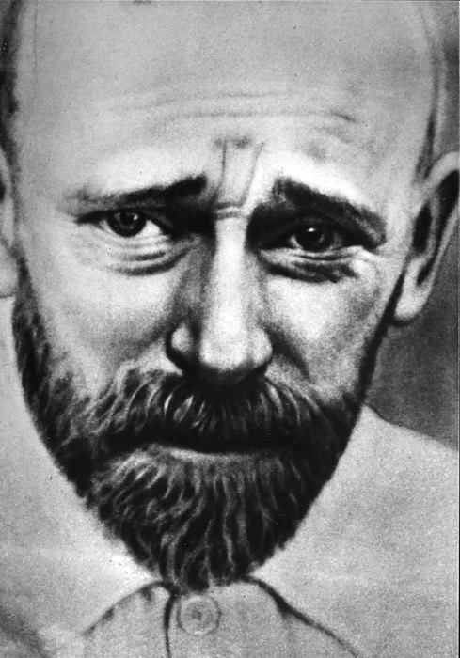
JANUSZ KORCZAK in poetry
Janusz Korczak- a great man
did everything he ever can
to make the world a better place
and see a smile on every face.
When the hard times had come
and all the children were taken to the place so scary and glum
he went with them all the way
and died in the gas chamber.
The only thing is here to say:
We will always remember!
The author:
Vanessa Malosczyk VIIC

Slide 5
Board Game
Game Rules
Object of the game:
Answer as many questions as possible and be the first to reach the finish line.
How to play:
All players begin the game on the "START" field.
The youngest player starts the game. She draws a card and if she answers correctly, she rolls a dice and moves her counter forward the amount she rolled. If she answers wrongly, she doesn't throw.
End of the game:
The game ends when one of the players reaches the "FINISH" field.
THE AUTHOR : Piotr Roztoczyński VIID

Slide 6
GAME CARDS
THE AUTHOR :
Piotr Roztoczyński VIID

Slide 7
RHYMES ABOUT SOME TEACHERS 😊
Our geography teacher is hard-working and clever and we will like her forever!
Our English teacher teaches us vocabulary and grammar so we will speak English better than Obama!
Our history teacher tells us about the kings and the wars and he always lets us stick important dates on the doors.
The P.E. teachers often go to the gym and they also like to swim.
THE AUTHOR: Amelia Ratman

Slide 8
WORD PUZZLES

Slide 9
The school building (23 KILIŃSKIEGO STREET)
The author: Milena Gil VII D

Slide 10
OuR school IN POETRY
2021 is a very important year
Because my school celebrates 35th birthday!
My school has got the number 4
Listen and I will tell you more…
It’s set on Kilińskiego 23
And it’s a very nice place to be 😊
I like my colourful school
Come here and learn- you won’t be a fool!
So, happy birthday my primary school!
I think that you are really cool!
The author:
Zuzanna Gawron VIID

Slide 11
OuR school IN POETRY
I used to go to school every morning,
but now it’s closed and the days are boring
I always thought the school is fine
But now the lessons are online
I hope that everything will change soon
And we will come back to our wonderful school !!!
The author:
Paulina Fudala VII B

Slide 12
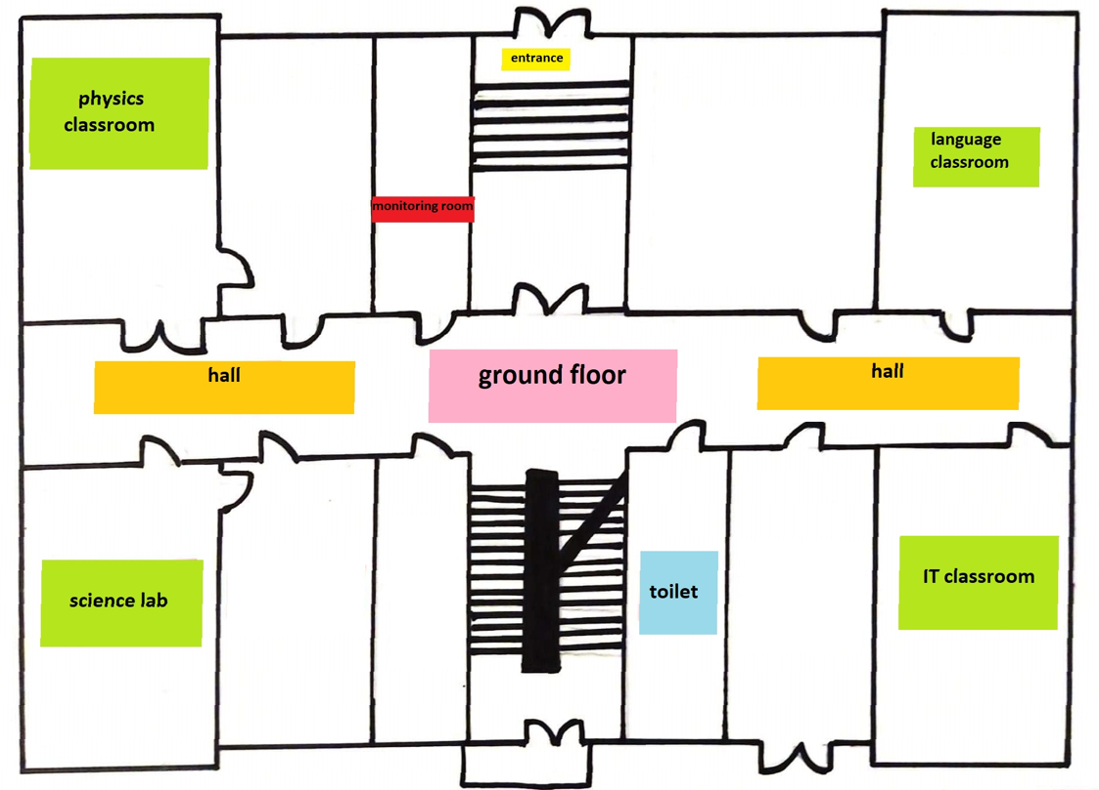
The school building (4 Konarskiego street)
The author:
Lena Olbrych VIID

Slide 13
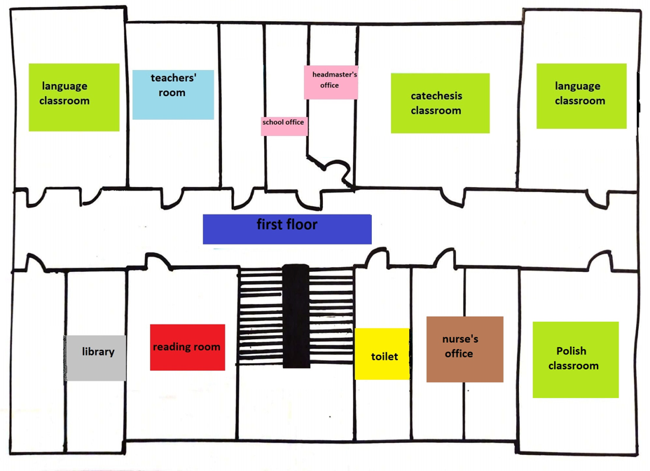
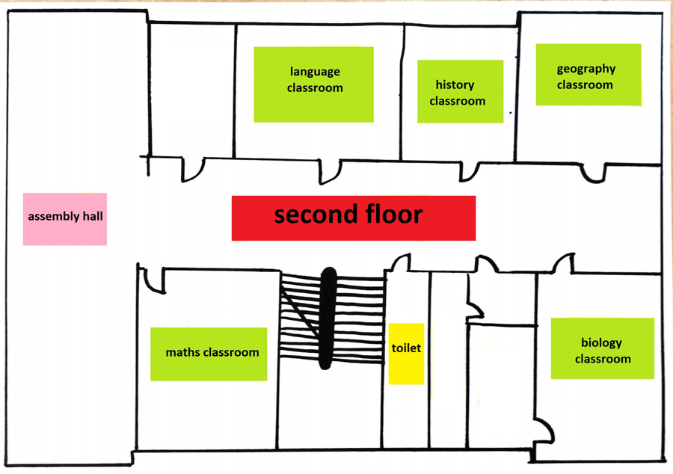
The school building (4 Konarskiego street)
The author:
Lena Olbrych VIID

Slide 14
The author:
Zofia Kułacz VIIB

